Slide 1

Hotel Reservation
title
Rahma Mahmoud

Slide 2

Agenda
Introduction
Excel
Import Data
SQL Server
Conclusion

Slide 3

Introduction
At the core of the dataset lies the reservation details, including the unique booking ID, arrival and departure dates, and the chosen meal plan. These attributes offer a glimpse into booking patterns, guest preferences for meal inclusions, and potential revenue streams for hotels. Additionally, the dataset includes information about the number of adults and children associated with each reservation, allowing hotels to anticipate occupancy levels and provide tailored services for families or groups of varying sizes.

Slide 4

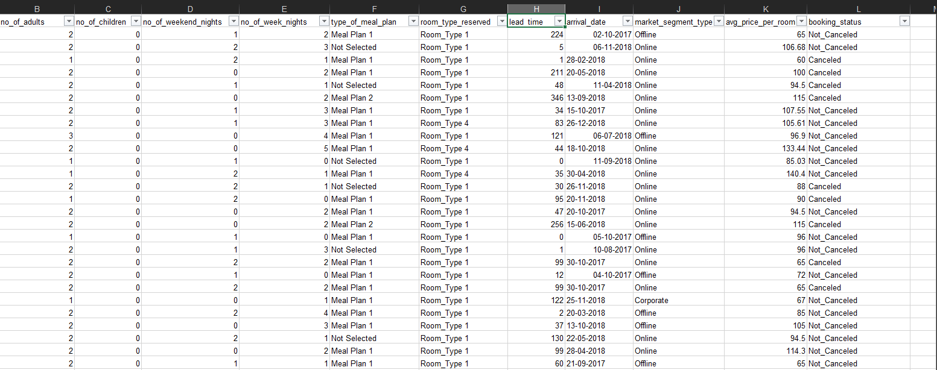
Excel

Slide 5
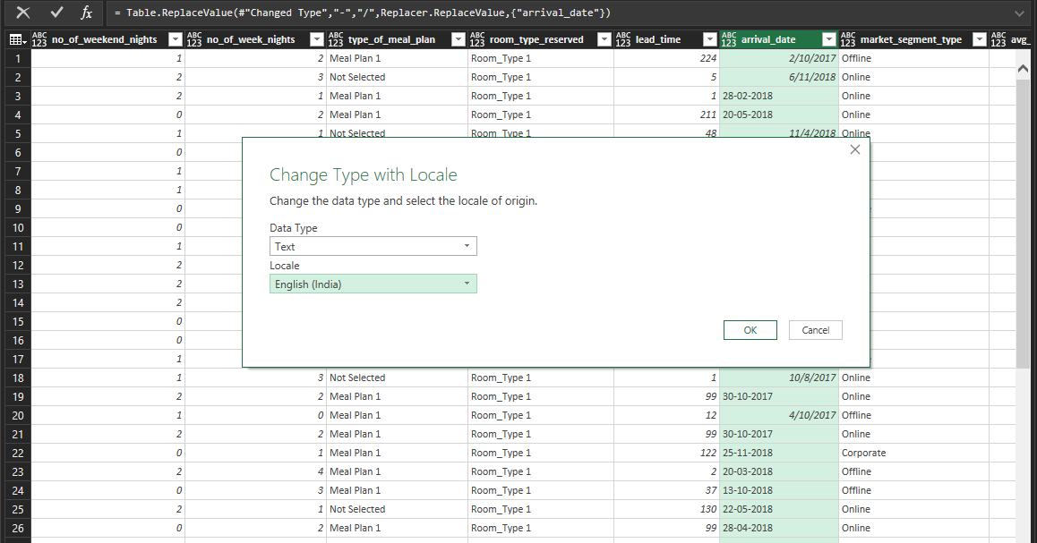
Transform Data By Power Query

Slide 6
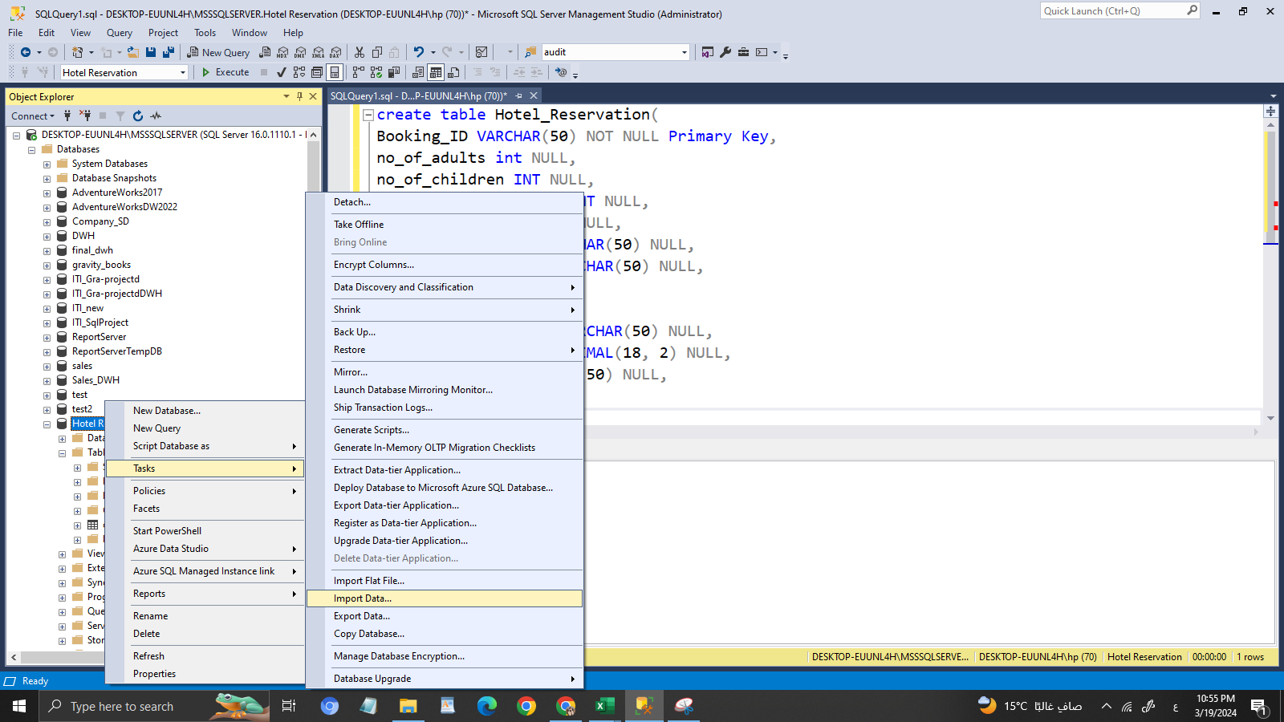
Import Data to SQL Server

Slide 7
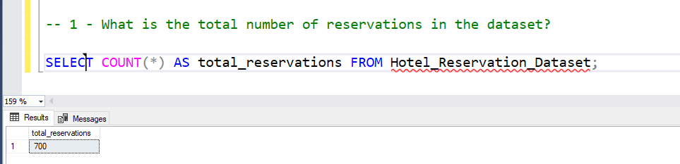
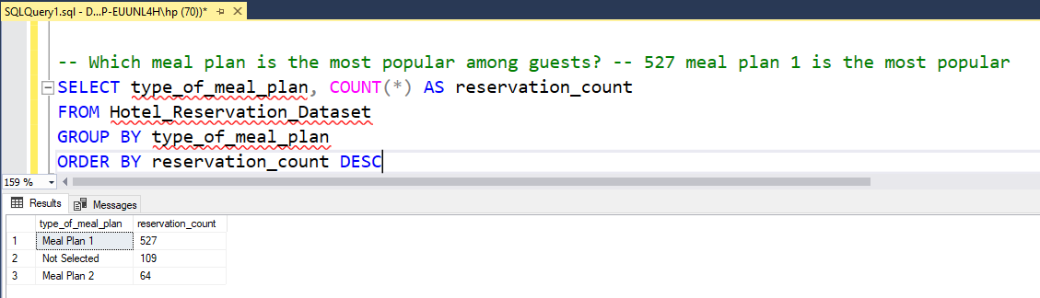
SQL Query

Slide 8
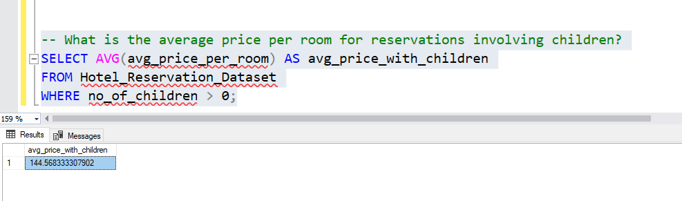
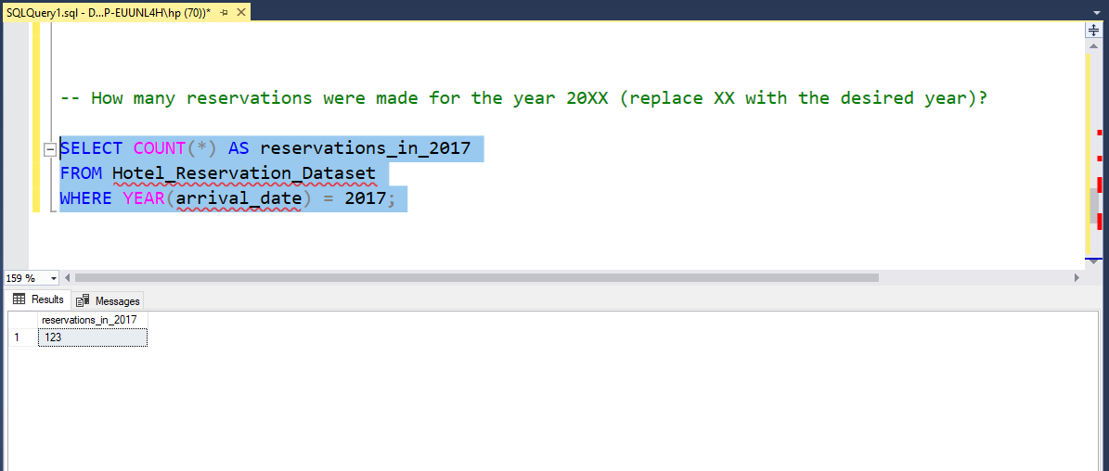
SQL Query

Slide 9
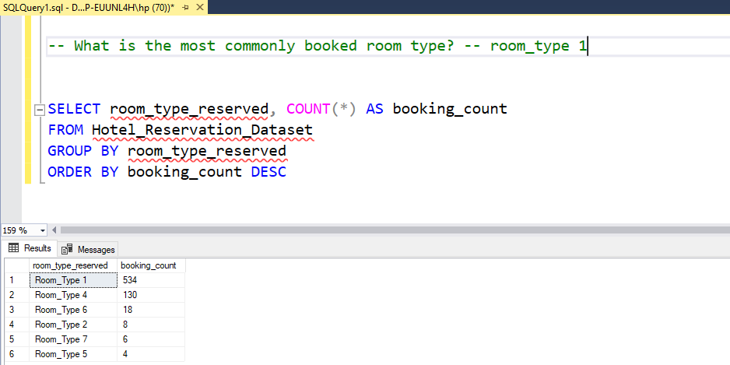
SQL Query

Slide 10
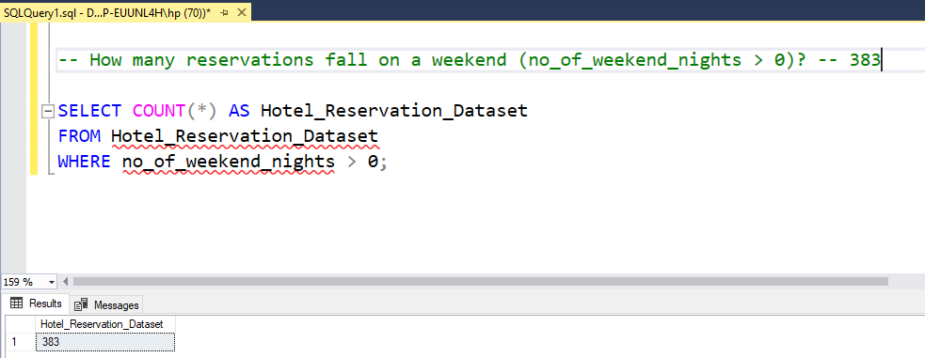
SQL Query

Slide 11
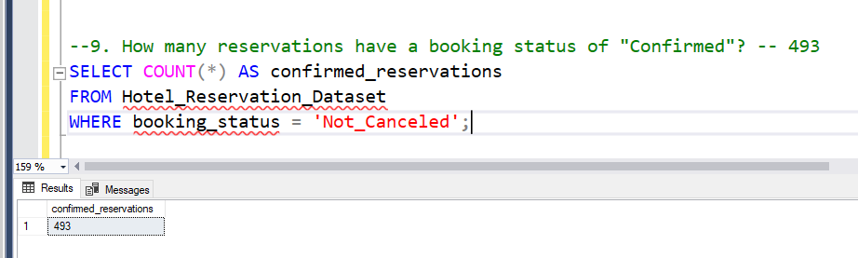
SQL Query

Slide 12
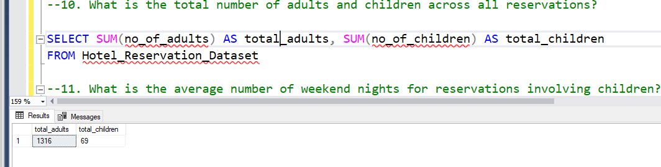
SQL Query

Slide 13
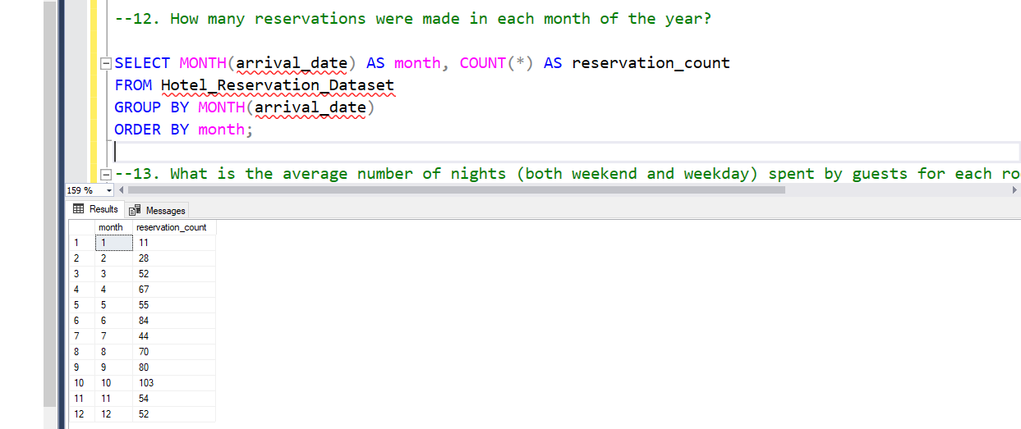
SQL Query

Slide 14
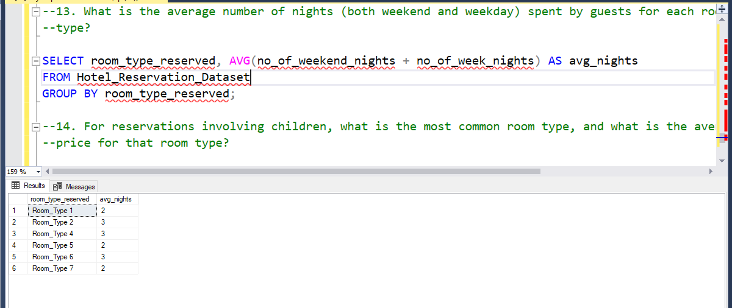
SQL Query

Slide 15
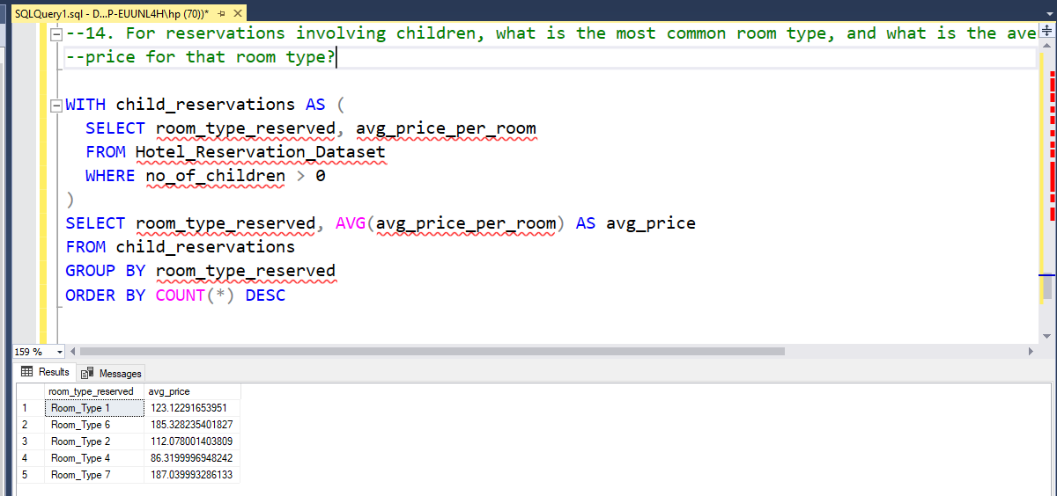
SQL Query

Slide 16
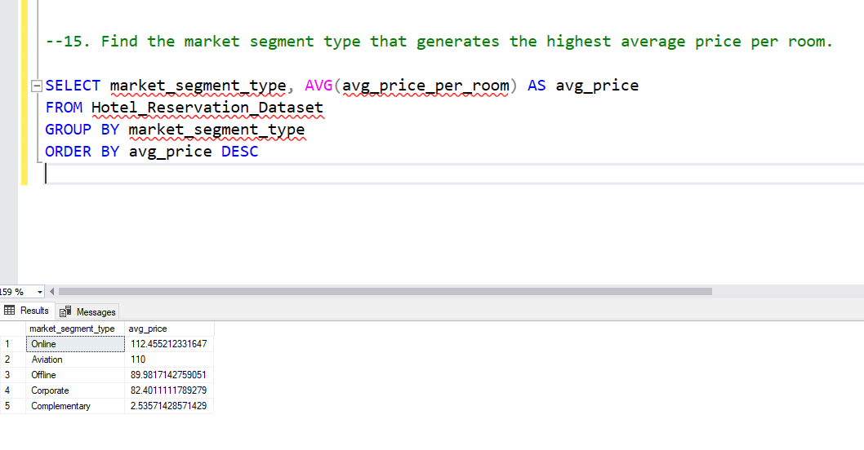
SQL Query

Slide 17

Conclusion
- Understand the dataset columns and structure.
- Write SQL queries to answer 15 specific questions provided.
- Use SQL aggregate functions, joins, and filters to extract necessary information.
- Analyze the results to gain insights into guest behaviors, booking patterns, and market trends.

